Slide 1

Legislative Update
2020

Slide 2
WELCOME
Matthew L. Boyatt
Deputy General Counsel
North Carolina Sheriffs' Association

Slide 3
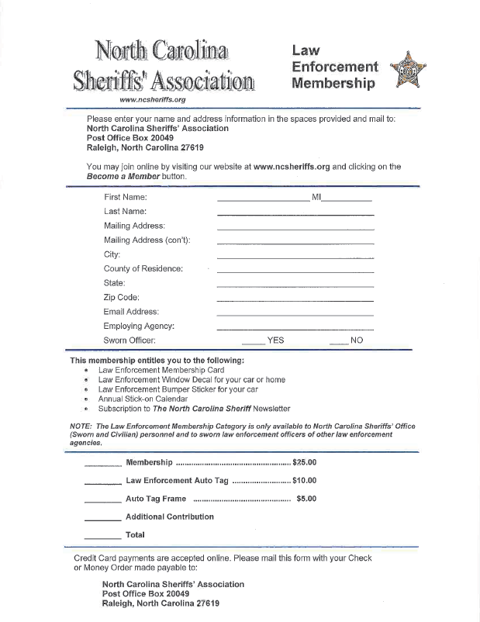
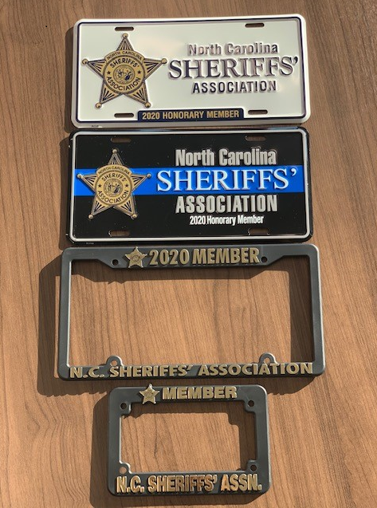
North Carolina Sheriffs' Association Law Enforcement Honorary Membership

Slide 4
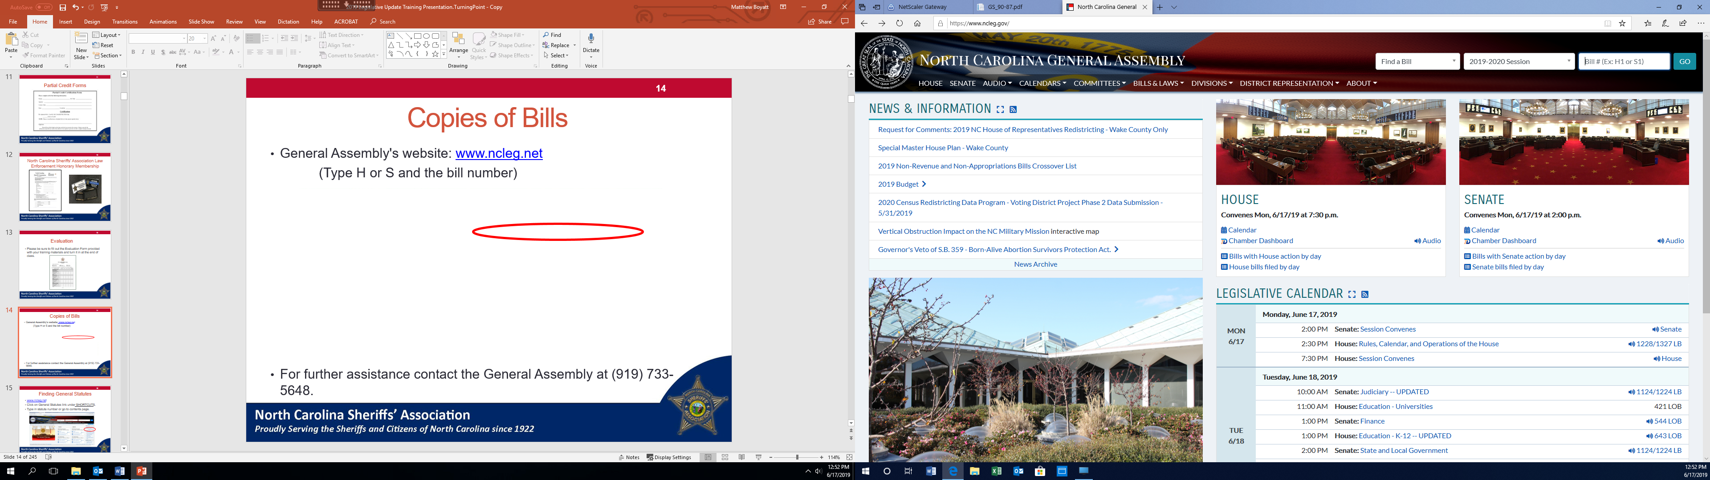
Copies of Bills
General Assembly's website: www.ncleg.gov
(Type H or S and the bill number)
For further assistance contact the General Assembly at
(919) 733-4111.

Slide 5
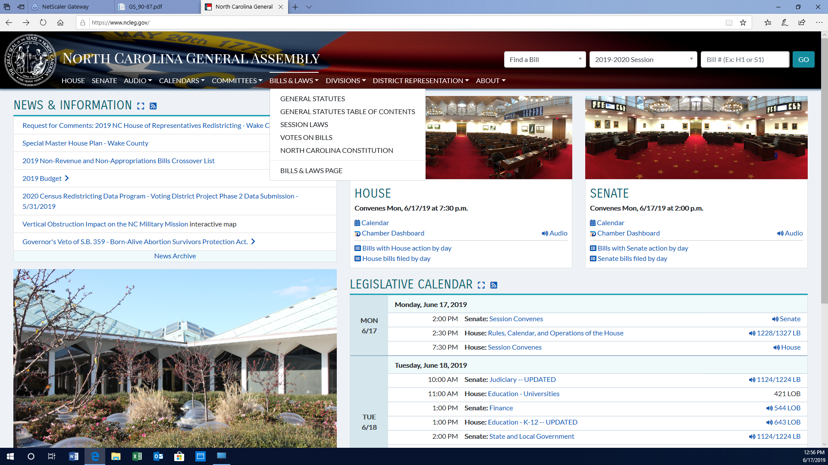
Finding General Statutes
www.ncleg.gov
Click on General Statutes link under “BILLS & LAWS.”
You can then navigate to the General Statutes contents page.

Slide 6
Finding Court Cases
Supreme Court of the United States
www.supremecourt.gov/
- Go to opinions
Supreme Court of North Carolina
North Carolina Court of Appeals
https://appellate.nccourts.org/opinions/
- Select year
- Date of opinion
- Look for name

Slide 7
Course Outline
  Welcome and Announcements
  2020 Bills of Interest
  Adjourn

Slide 8
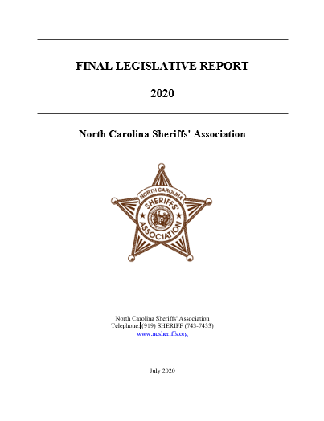
Final Legislative Report Available Online

Slide 9
Training Materials
All 2020 Legislative Update Training materials can be found at:
http://ncsheriffs.org/2020-legislative-update

Slide 10
QUESTIONS?
?

Slide 11
2020 General Assembly
During the 2019 - 2020 Session of the General Assembly, 1,236 House Bills and 870 Senate Bills were introduced, for a total of 2,106 new legislative bills available for consideration.
371 Bills were enacted into law.
Governor Roy Cooper:
  Signed 272 bills;
  Allowed 4 to become law without his signature; and
  Vetoed 25 bills, with none of the Governor’s vetoes being
  overridden by the General Assembly.

Slide 12
2020 Bills of Interest
Matthew L. Boyatt
Deputy General Counsel
North Carolina Sheriffs’ Association

Slide 13
House Bill 85
Emissions/Lee, Onslow & Rockingham Counties
Amends G.S. 143-215.107A.
Removes Lee, Onslow and Rockingham counties from the requirement for motor vehicle emissions testing under North Carolina’s emissions testing program.
Becomes effective on January 1, 2021 or the first day of a month that is 60 days after the United States Environmental Protection Agency approves the changes in this emissions testing program, whichever date occurs later.

Slide 14
House Bill 85 (continued)
Emissions/Lee, Onslow & Rockingham Counties
Currently, motor vehicle emissions testing is only required in the following counties: Alamance, Buncombe, Cabarrus, Cumberland, Davidson, Durham, Forsyth, Franklin, Gaston, Guilford, Iredell, Johnston, Lee, Lincoln, Mecklenburg, New Hanover, Onslow, Randolph, Rockingham, Rowan, Union and Wake.

Slide 15
House Bill 307
Mod. Utility Vehicle Classification
Amends G.S. 20-4.01.
Includes in our motor vehicle laws, Chapter 20 of the North Carolina General Statutes, a new classification of vehicle called a “modified utility vehicle.”

Slide 16
House Bill 307 (continued)
Mod. Utility Vehicle Classification
Modified utility vehicle is now defined in G.S. 20-4.01(27) as a four-wheeled motor vehicle that is manufactured for off-road use with an engine displacement greater than 2,400 cubic centimeters, an overall length of 142 inches (11.8 feet) or greater, an overall width of 58 inches (4.8 feet) or greater, an overall height of 70 inches (5.8 feet) or greater, a maximum speed capability of 40 miles per hour or greater, and that does not require an operator or passenger to straddle a seat.

Slide 17
House Bill 307 (continued)
Mod. Utility Vehicle Classification
The bill also amends G.S. 20-121.1 to allow the use of modified utility vehicles on streets and highways where the posted speed limit is 55 miles per hour or less.
These vehicles must be insured, registered with the NCDMV, and must be equipped with the common safety features associated with a motor vehicle (such as a horn, turn signals, headlights, etc.).
Effective: October 1, 2020

Slide 18
House Bill 307 (continued)
Mod. Utility Vehicle Classification
Note: Modified utility vehicles are commonly used on farms to haul feed, hay, and supplies as well as at schools, where they are used to transport water jugs, sports equipment and occasionally athletes.
All-terrain vehicles and golf carts are not included in this definition.

Slide 19
House Bill 308
Regulatory Reform Act of 2020
Amends G.S. 14-258.1.
Clarifies that a sheriff or other person in charge of a local confinement facility may authorize inmates to use a mobile telephone or other wireless communications device (such as a tablet) that has been approved for use by inmates by the sheriff or other person in charge of the local confinement facility.
Effective: August 1, 2020

Slide 20
House Bill 308 (continued)
Regulatory Reform Act of 2020
Prior to this amendment to G.S. 14-258.1, the Division of Adult Correction and Juvenile Justice of the North Carolina Department of Public Safety (DPS) was authorized to approve the use of a mobile telephone or other wireless communications device (such as a tablet) by inmates in our State prisons.
This provision of law authorizing DPS to approve the use of certain wireless communications devices by inmates in State prisons has not changed.

Slide 21
House Bill 308 (continued)
Regulatory Reform Act of 2020
Amends G.S. 116-40.5.
Allows campus law enforcement agencies that are part of a teaching hospital to enforce the criminal laws on the premises of any other facility owned or leased by the teaching hospital that is within the hospital’s health network.

Slide 22
House Bill 308 (continued)
Regulatory Reform Act of 2020
The bill does NOT expand the jurisdiction of the campus law enforcement officers beyond the premises of the teaching hospital’s remote facility, whether that facility is a hospital facility or a doctor’s office.
Therefore, the jurisdiction of campus police in this remote facility scenario does NOT include public roads or highways passing through the facility or to any property immediately adjoining the facility or doctor’s office.

Slide 23
House Bill 308 (continued)
Regulatory Reform Act of 2020
These provisions were requested by Vidant Health, which owns and operates numerous doctors’ offices and health care facilities in Eastern North Carolina.
- Effective: July 1, 2020

Slide 24
House Bill 308 (continued)
Regulatory Reform Act of 2020
Note: Nothing in the amendment to G.S. 116-40.5 changes the authority of campus law enforcement agencies now operating on the premises of a teaching hospital.
Currently, those agencies are authorized to enforce the criminal laws on the premises of the teaching hospital and on public roads or highways passing through the premises of the hospital.

Slide 25
House Bill 425
Implement Conner’s Law
Appropriates $1.2 million to the North Carolina Department of State Treasurer for the 2020-2021 fiscal year for the payment of death benefits provided under Conner’s Law (SL 2019-228).
Conner’s Law provides an extra $100,000 death benefit for the spouse, dependents, or dependent parents of a first responder that is murdered in the line of duty.

Slide 26
House Bill 425 (continued)
Implement Conner’s Law
Conner’s Law also increases the punishment for anyone convicted of assault with a firearm on a law enforcement officer, probation officer or parole officer, or for an assault with a deadly weapon against other emergency responders.
- Effective: July 1, 2020

Slide 27
House Bill 511
North Carolina First Step Act
Amends G.S. 90-95(h).
Authorizes a judge in a drug trafficking case to reduce fines and impose a sentence lower than the applicable mandatory minimum prison term only if ALL of the following findings of fact are made by the court:

Slide 28
House Bill 511 (continued)
North Carolina First Step Act
Imposition of the mandatory minimum prison term would result in substantial injustice.
The defendant accepted responsibility for the criminal conduct.
The defendant has agreed to participate in drug treatment.

Slide 29
House Bill 511 (continued)
North Carolina First Step Act
The defendant has not been convicted of a prior felony drug conviction and did not use violence or a firearm or other deadly weapon in the commission of the drug trafficking offense.
The defendant is being sentenced solely for trafficking or conspiracy to commit trafficking as a result of possession of a controlled substance.

Slide 30
House Bill 511 (continued)
North Carolina First Step Act
There is not substantial evidence that the defendant has ever engaged in the sale, manufacture, delivery, or transport for the purpose of sale of a controlled substance or that the defendant has ever had the intent to sell, manufacture, deliver, or transport for the purpose of sale a controlled substance.
The defendant has provided reasonable assistance in the identification, arrest, or conviction of any accomplices, accessories, or co-conspirators.

Slide 31
House Bill 511 (continued)
North Carolina First Step Act
And finally, that the defendant is being sentenced for trafficking or conspiracy to commit trafficking for possession of an amount of a controlled substance that is not of a quantity greater than the lowest category for which a defendant may be convicted for trafficking of that controlled substance.
Note: Again, all 8 of these factors must be met for a judge to reduce fines and impose a sentence lower than the applicable mandatory minimum prison term in a drug trafficking case.

Slide 32
House Bill 511 (continued)
North Carolina First Step Act
Amended G.S. 90-95(h) requires the court to conduct a hearing prior to imposing a sentence lower than the applicable mandatory minimum prison term.
The district attorney must be allowed to present evidence at this hearing, including evidence from the investigating law enforcement officer, other law enforcement officers or from witnesses with knowledge of the defendant’s conduct.

Slide 33
House Bill 511 (continued)
North Carolina First Step Act
Amends G.S. 90-95.
Requires the North Carolina Administrative Office of the Courts to publish an annual report, beginning on December 1, 2021, of all drug trafficking convictions from the previous year that have had sentences modified from the mandatory minimum sentence pursuant to the above provisions.
Effective: December 1, 2020 and applies to sentences ordered on or after that date.

Slide 34
House Bill 593
JCPC/Detention/CAA and Other Fees
Amends G.S. 7A-304.
Provides an additional $1.00 in court costs funding to the North Carolina Criminal Justice Education and Training Standards Commission.
This increases from $2.00 to $3.00 the amount of court costs allocated to the Commission.
Effective: December 1, 2020

Slide 35
House Bill 593 (continued)
JCPC/Detention/CAA and Other Fees
The bill amends various provisions in our General Statutes to ensure that NO juvenile under the age of 18 is confined in a county jail unless an agreement exists between the county jail and the Division of Adult Correction and Juvenile Justice (DACJJ) of the North Carolina Department of Public Safety.
Those amendments of interest to the criminal justice community include:

Slide 36
House Bill 593 (juvenile changes continued)
JCPC/Detention/CAA and Other Fees
Amends G.S. 153A-218.
Prohibits any person under the age of 18 from being held in a local confinement facility (such as a county jail) unless there is an agreement between the local confinement facility and DACJJ for the housing of juveniles at the facility.

Slide 37
House Bill 593 (juvenile changes continued)
JCPC/Detention/CAA and Other Fees
Amends G.S. 7A-109.3.
Requires all district and superior court commitment orders for persons under the age of 18 to be forwarded to a detention facility approved by DACJJ as a facility that can provide for the secure confinement and care of juveniles.
The commitment order must be forwarded within 48 hours of entry of the sentence.

Slide 38
House Bill 593 (juvenile changes continued)
JCPC/Detention/CAA and Other Fees
Amends G.S. 15-6.
Prohibits any person under the age of 18 from being imprisoned in a county jail unless the county jail has been approved by DACJJ as a facility that can provide for the secure confinement and care of juveniles.

Slide 39
House Bill 593 (juvenile changes continued)
JCPC/Detention/CAA and Other Fees
Amends G.S. 15A-521.
Prohibits any person under the age of 18 from being held in a county jail pending trial unless the county jail has been approved by DACJJ as a facility that can provide for the secure confinement and care of juveniles.
Amended G.S. 15A-521 also requires DACJJ staff to make all transfers to and from court so long as the juvenile remains in custody pending trial.

Slide 40
House Bill 593 (juvenile changes continued)
JCPC/Detention/CAA and Other Fees
If the juvenile being held reaches the age of 18 while awaiting trial, the bill requires DACJJ to transfer the juvenile back to the custody of the sheriff in the county where the charges arose.

Slide 41
House Bill 593 (juvenile changes continued)
JCPC/Detention/CAA and Other Fees
Amends G.S. 15A-1301.
Requires a court, when entering an order of commitment to imprison a juvenile, to commit the juvenile to a detention facility that has been approved by DACJJ as a facility that can provide for the secure confinement and care of juveniles.

Slide 42
House Bill 593 (juvenile changes continued)
JCPC/Detention/CAA and Other Fees
Amends G.S. 15A-1343.
Requires any person under the age of 18 that receives a “quick dip” (short period of confinement for violating a condition of probation) that is imposed by the court to serve that period of confinement in a detention facility that has been approved by DACJJ as a facility that can provide for the secure confinement and care of juveniles.

Slide 43
House Bill 593 (juvenile changes continued)
JCPC/Detention/CAA and Other Fees
Amends G.S. 15A-1343.2.
Requires any person under the age of 18 that receives a quick dip that is imposed by a probation officer to serve that period of confinement in a detention facility that has been approved by DACJJ as a facility that can provide for the secure confinement and care of juveniles.

Slide 44
House Bill 593 (juvenile changes continued)
JCPC/Detention/CAA and Other Fees
Amends G.S. 15A-1344.
Requires any person under the age of 18 that is confined for a felony or misdemeanor probation violation, or when serving a split sentence as a modification of probation, to serve that period of confinement in a detention facility that has been approved by DACJJ as a facility that can provide for the secure confinement and care of juveniles.

Slide 45
House Bill 593 (juvenile changes continued)
JCPC/Detention/CAA and Other Fees
Amends G.S. 15A-1351.
Requires any person under the age of 18 that is serving a period of confinement under a split sentence, including for driving while impaired, to serve that period of confinement in a detention facility that has been approved by DACJJ as a facility that can provide for the secure confinement and care of juveniles.

Slide 46
House Bill 593 (juvenile changes continued)
JCPC/Detention/CAA and Other Fees
Amends G.S. 15A-1352.
Requires any person under the age of 18 that is serving a period of confinement for a misdemeanor, including driving while impaired, to serve that period of confinement in a detention facility that has been approved by DACJJ as a facility that can provide for the secure confinement and care of juveniles.
Effective: August 1, 2020 and applies to offenses committed,
sentences imposed, and any other orders of imprisonment
issued on or after that date.

Slide 47
House Bill 593 (safekeeper changes)
JCPC/Detention/CAA and Other Fees
Amends G.S. 148-19.3.
Clarifies that all medical invoices for health care services provided to Statewide Misdemeanant Confinement Program (SMCP) safekeepers are to be submitted by the out-of-prison health care provider (i.e. external hospital or doctor) directly to the Inmate Medical Costs Management Plan (Plan) through the North Carolina Sheriffs’ Association.
The Plan is then required to review and negotiate all invoiced charges for medical services provided to ANY SMCP safekeepers.

Slide 48
House Bill 593 (safekeeper changes continued)
JCPC/Detention/CAA and Other Fees
Amended G.S. 148-19.3 also clarifies that in the event an out-of-prison health care provider submits an SMCP safekeeper invoice to the North Carolina Department of Public Safety (DPS) in error, DPS is required to forward the invoice to the Plan within three days of receipt of the invoice.
Once medical invoices are processed by the Plan, all unreimbursed charges (those not covered by Medicare, Medicaid or the inmate’s personal health insurance) will be documented and presented by the Plan to the county directly for payment.

Slide 49
House Bill 593 (safekeeper changes continued)
JCPC/Detention/CAA and Other Fees
Amends G.S. 148-32.1.
Limits the initial time period a SMCP safekeeper will stay in the custody of the DACJJ to a period of 30 days.
DACJJ is required to have their medical or mental health professionals conduct an assessment of the prisoner during this 30-day period and to make recommendations as to whether the prisoner should remain in the custody of the DACJJ or be returned to the county.

Slide 50
House Bill 593 (safekeeper changes continued)
JCPC/Detention/CAA and Other Fees
To have the safekeeper order extended beyond the initial 30-day period, the sheriff is required to provide the DACJJ assessment and any other relevant information to a district or superior court judge, who will make a determination as to whether the safekeeper should remain in DACJJ custody beyond the initial 30-day period.

Slide 51
House Bill 593 (safekeeper changes continued)
JCPC/Detention/CAA and Other Fees
If the court decides to extend the SMCP safekeeper order beyond the initial 30-day period, the court must set a date certain to have the matter brought back to court for further review. In the event the order is extended, DACJJ is required to conduct another assessment of the prisoner prior to the next scheduled hearing.
Effective: July 1, 2020 and applies to all SMCP safekeepers transferred on or after that date.

Slide 52
House Bill 593 (Grabarczyk)
JCPC/Detention/CAA and Other Fees
North Carolina Sex Offender Registry - Grabarczyk v. Stein, et al.
The bill addresses an issue created by the federal court case of Grabarczyk v. Stein, et al. No. 5:19-CV-48-BO, which without legislative action would have removed many sex offenders from the North Carolina Sex Offender Registry (SOR) who were placed on the SOR due to an out-of-state conviction or a federal conviction that is “substantially similar” to a North Carolina crime that would require registration on the SOR.

Slide 53
House Bill 593 (Grabarczyk continued)
JCPC/Detention/CAA and Other Fees
Amends Chapter 14 to ensure the following sex offenders are required to register in North Carolina if their out-of-state or federal crime is substantially similar to a North Carolina crime requiring registration:
Those sex offenders who are members of the class identified in Grabarczyk v. Stein.

Slide 54
House Bill 593 (Grabarczyk continued)
JCPC/Detention/CAA and Other Fees
Those sex offenders who are not members of the class identified in Grabarczyk v. Stein but are on the SOR as of August 1, 2020 because they have a substantially similar out-of-state conviction or federal conviction requiring registration.
Those sex offenders who will come on the SOR after August 1, 2020 because they have a substantially similar out-of-state conviction or federal conviction requiring registration.

Slide 55
House Bill 593 (Grabarczyk continued)
JCPC/Detention/CAA and Other Fees
Enacts new G.S. 14-208.12B.
Provides the following judicial review and notice requirements for the classifications of sex offenders identified above:
Requires the North Carolina State Bureau of Investigation to provide all district attorneys with a list of sex offenders who are members of the class identified in Grabarczyk v. Stein that reside in a county in that district attorney’s district.

Slide 56
House Bill 593 (Grabarczyk continued)
JCPC/Detention/CAA and Other Fees
The district attorney, or the Attorney General if requested by the district attorney, is required to review the files of these sex offenders for a preliminary determination of substantial similarity to a North Carolina crime requiring registration.
If the reviewing agency determines substantial similarity exists, the agency is required to notify the sex offender and the sheriff of the county where the sex offender resides.

Slide 57
House Bill 593 (Grabarczyk continued)
JCPC/Detention/CAA and Other Fees
The agency may then petition the court for judicial review of the registration to avoid the sex offender from being removed from the SOR.
Remember, this process is for those sex offenders who are members of the class in the Grabarczyk case.

Slide 58
House Bill 593 (Grabarczyk continued)
JCPC/Detention/CAA and Other Fees
The bill also requires the North Carolina Department of Public Safety to notify every sex offender that is on the SOR on August 1, 2020 based upon a substantially similar out-of-state or federal conviction of their right to seek judicial review of their registration requirement.

Slide 59
House Bill 593 (Grabarczyk continued)
JCPC/Detention/CAA and Other Fees
The bill requires the sex offender to request judicial review within 30 days in the county where the sex offender resides and the sex offender is required to give notice of the petition to the sheriff and the district attorney within three days of filing the petition.

Slide 60
House Bill 593 (Grabarczyk continued)
JCPC/Detention/CAA and Other Fees
For sex offenders coming on the SOR that are not a part of the Grabarczyk lawsuit and are not already on the SOR as of August 1, 2020, the bill requires the sheriff to notify the sex offender of their right to seek judicial review if the sheriff determines the person must register based upon a substantially similar out-of-state conviction or federal conviction that requires registration in North Carolina.

Slide 61
House Bill 593 (Grabarczyk continued)
JCPC/Detention/CAA and Other Fees
Once notified, the sex offender has the option to file a petition for judicial review within 30 days in the county where the sex offender resides.
If the sex offender files a petition for judicial review, the sex offender is required to give notice of the petition to the sheriff and the district attorney within three days of filing the petition.

Slide 62
House Bill 593 (Grabarczyk continued)
JCPC/Detention/CAA and Other Fees
The judicial review will be by a superior court judge presiding in the district where the sex offender resides and will be limited to a determination of whether or not the person's out-of-state conviction or federal conviction is substantially similar to a North Carolina crime that requires registration.
The State has the burden of showing that the out-of-state or federal conviction is for a crime that is substantially similar to a North Carolina crime that requires registration.

Slide 63
House Bill 593 (Grabarczyk continued)
JCPC/Detention/CAA and Other Fees
These sex offender registry provisions for the judicial review of substantially similar out-of-state offenses became effective August 1, 2020 and apply to any individual notified of the right to contest registration on or after that date.

Slide 64
House Bill 902
P&C Changes/Glob. Tranp./Prison Pilot
Transfers $1.8 million to the North Carolina Department of Public Safety, Division of Adult Correction and Juvenile Justice (DACJJ), for the 2020-2021 fiscal year for the development and administration of a Prison Software Management Pilot Program to be implemented at Bertie Correctional Institution and Pasquotank Correctional Institution.

Slide 65
House Bill 902 (continued)
P&C Changes/Glob. Tranp./Prison Pilot
The purpose of the Prison Pilot Program is to provide equipment and software upgrades to the State Prison Management Information Systems and to deploy a mobile inmate tracking system.
This will enable the creation of a new shared database platform to replace the current OPUS System. The bill directs DACJJ to begin operating the Prison Pilot Program by October 15, 2020.
- Effective: July 1, 2020

Slide 66
House Bill 1043
Pandemic Response Act
The bill requires the State Controller to transfer (to the extent federal funding becomes available) $1,275,988,029 in nonrecurring funds for the 2019-2020 fiscal year to the Coronavirus Relief Fund, which will be administered by the North Carolina Office of State Budget and Management (OSBM) for COVID-19 recovery efforts.

Slide 67
House Bill 1043 (continued)
Pandemic Response Act
Of these anticipated federal funds (and assuming the proposed uses below are allowable under federal guidelines):
OSBM is required to allocate $50 million to various entities listed in the bill to purchase personal protective equipment (PPE) and other health care supplies (such as ventilators) that will be used by health care providers and first responders, such as law enforcement officers, in responding to the COVID-19 pandemic.

Slide 68
House Bill 1043 (continued)
Pandemic Response Act
OSBM is required to allocate $70 million for operational needs across State government, which may include allocating a portion of these funds to pay for overtime costs in State prisons and juvenile facilities, providing COVID-19 testing for employees of the North Carolina Department of Public Safety, Division of Prisons, and for purchasing emergency hygiene and sanitation supplies to assist with COVID-19.

Slide 69
House Bill 1043 (continued)
Pandemic Response Act
Provided the North Carolina Department of Health and Human Services (DHHS) meets certain criteria set out in the bill, OSBM is required to allocate $25 million to DHHS for use by the agency to increase the capacity for COVID-19 diagnostic testing and antibody testing throughout the State.

Slide 70
House Bill 1043 (continued)
Pandemic Response Act
OSBM is required to allocate $400,000 in nonrecurring funds to the North Carolina Department of Health and Human Services, Division of Mental Health, Developmental Disabilities, and Substance Abuse Services for the purchase of units of opioid antagonist to prevent overdose deaths.
- Effective: May 4, 2020

Slide 71
House Bill 1062
Beaufort County/Animal Service Records
This is a local bill that applies only to Beaufort County.
The bill exempts from public records any personal identifying information held by the Beaufort County animal services agency related to an individual who voluntarily surrendered ownership of an animal to an animal shelter, an individual who adopted a shelter animal, or an individual to whom a shelter animal has been placed through a foster program.
- Effective: June 10, 2020

Slide 72

House Bill 1063
Fund VIPER Tower Hardware Upgrades
Appropriates $19.8 million in nonrecurring funds from the Coronavirus Relief Fund for allocation to the North Carolina Department of Public Safety for the 2020-2021 fiscal year for hardware and software upgrades to the Voice Interoperability Plan for Emergency Responders (VIPER).
- Effective: July 1, 2020

Slide 73
House Bill 1064
GSC Clarifying Bingo License Statute
Amends G.S. 14-309.7, G.S. 14- 309.11, and G.S. 14-309.14.
These amendments make the Alcohol Law Enforcement Division of the North Carolina Department of Public Safety responsible for issuing bingo licenses, annual or semiannual bingo game limited occasion permits, and beach bingo licenses.

Slide 74
House Bill 1064 (continued)
GSC Clarifying Bingo License Statute
Previously, the North Carolina State Bureau of Investigation was responsible for the issuance of these licenses and permits.
Effective: October 1, 2020 and applies to applications
submitted on or after that date.

Slide 75
House Bill 1157
Abolish Coroner in Various Counties
This is a local bill that applies only to Montgomery, Avery, Bladen and Hoke counties and that abolishes the office of coroner in these counties.
Effective June 17, 2020, the office of coroner in Montgomery County is abolished.

Slide 76
House Bill 1157 (continued)
Abolish Coroner in Various Counties
Effective January 1, 2021, the office of coroner in Avery, Bladen, and Hoke counties is abolished.
But, any coroner elected in the 2018 or 2020 general election in any of these counties will be allowed to finish the remainder of their current term.

Slide 77
House Bill 1157 (continued)
Abolish Coroner in Various Counties
If a vacancy in the office of coroner should occur following the 2018 or 2020 general election in any of these counties, a new coroner may be appointed to fulfill the remainder of the term.
Note: Yadkin County will be the only county remaining to have an office of coroner once the counties listed above have their office of coroner abolished pursuant to the effective dates noted above and the fulfillment of any remaining terms of office.

Slide 78
House Bill 1157 (continued)
Abolish Coroner in Various Counties
The abolishment of the office of coroner in a county is important because of the potential for a vacancy in the Office of Sheriff.
G.S. §§ 162-5 and 162-5.1 address who “performs all the duties of the sheriff” in the event a vacancy occurs in the Office of Sheriff.
Both statutes are similar, so we will focus on G.S. 162-5 and then explain briefly at the end of the presentation how G.S. 162-5.1 is different.

Slide 79
House Bill 1157 (continued)
Abolish Coroner in Various Counties
G.S. 162-5.
In the event a vacancy occurs in the Office of Sheriff, the elected coroner of the county shall perform all the duties of sheriff until the county commissioners “elect a sheriff” to fill the vacancy for the residue of the term.
So who performs the duties of the sheriff during the vacancy if there is no county coroner?

Slide 80
House Bill 1157 (continued)
Abolish Coroner in Various Counties
G.S. 162-5 (continued).
If there is no county coroner, the chief deputy shall perform all the duties of the sheriff and if no chief deputy has been designated, the “senior deputy in years of service shall perform all the duties of the sheriff” until the county commissioners fill the vacancy.

Slide 81
House Bill 1157 (continued)
Abolish Coroner in Various Counties
G.S. 162-5 (continued).
REMEMBER that the person who “performs all the duties of the sheriff” does not assume the role of sheriff and does not become the acting or interim sheriff.
This person merely “performs all the duties of the sheriff” during the period of the vacancy, which can be a permanent vacancy (such as retirement or death) or a temporary vacancy.

Slide 82
House Bill 1157 (continued)
Abolish Coroner in Various Counties
G.S. 162-5.1
What about G.S. 162-5.1 that was mentioned earlier?
G.S. 162-5.1 only applies to the specific counties listed in this statute. Those counties are, in alphabetical order:

Slide 83
House Bill 1157 (continued)
Abolish Coroner in Various Counties
Alamance, Alleghany, Avery, Beaufort, Brunswick, Buncombe, Cabarrus, Caldwell, Carteret, Cherokee, Clay, Davidson, Davie, Edgecombe, Forsyth, Gaston, Graham, Guilford, Haywood, Henderson, Hyde, Jackson, Lee, Lincoln, Madison, McDowell, Mecklenburg, Moore, New Hanover, Onslow, Pender, Polk, Randolph, Richmond, Rockingham, Rutherford, Sampson, Stokes, Surry, Transylvania, Wake, Washington, Wayne, and Yancey.

Slide 84
House Bill 1157 (continued)
Abolish Coroner in Various Counties
G.S. 162-5.1 (continued)
G.S. 162-5.1 contains the same basic provisions for filling a vacancy as in G.S. 162-5 that we covered above, except that the county executive committee of the political party of the former sheriff is authorized by statute to “make a recommendation” to the board of county commissioners on who will fill the vacancy if the sheriff was elected as a nominee of a political party.

Slide 85
House Bill 1157 (continued)
Abolish Coroner in Various Counties
If the county executive committee of the political party of the former sheriff makes a “recommendation” within 30 days of the occurrence of the vacancy, the board of county commissioners must elect the person recommended.

Slide 86
House Bill 1157 (continued)
Abolish Coroner in Various Counties
However, if the county executive committee of the political party of the former sheriff fails to make a recommendation within 30 days of the occurrence of the vacancy, the board of county commissioners will make the appointment and can elect anyone to fill the vacancy (regardless of political party) who is qualified to serve as sheriff.

Slide 87
House Bill 1157 (continued)
Abolish Coroner in Various Counties
Remember, if your county is not listed by name in G.S. 162-5.1, then G.S. 162-5 applies.
Avery County is the only county in House Bill 1157 that falls under G.S. 162-5.1 such that the political party of the former sheriff would make a “recommendation” on filling a vacancy.

Slide 88
House Bill 1187
Raise the Age Funding
The bill appropriates $10.4 million to the North Carolina Department of Public Safety for the 2020-2021 fiscal year for construction and renovation projects at the following youth detention centers:

Slide 89
House Bill 1187 (continued)
Raise the Age Funding
$2.7 million is appropriated for renovations at the Perquimans Youth Detention Center.
$5.7 million is appropriated for renovations at the C.A. Dillon Youth Development Center in Granville County.
$2 million is appropriated for construction projects at the Youth Development Center in Rockingham County.
- Effective: July 1, 2020

Slide 90
Senate Bill 232
Repeal Death Invest Conf/Masks/Health & Safety
Amends G.S. 14-12.11
Permanently authorizes a person to wear a mask in public and on private premises (such as in a shopping mall) for the purpose of ensuring the physical health or safety of the wearer or others.
The person wearing a mask for health or safety reasons must remove the mask upon the request of a law enforcement officer during a traffic stop (including at a checkpoint or roadblock) or criminal investigation.

Slide 91
Senate Bill 232 (continued)
Repeal Death Invest Conf/Masks/Health & Safety
Previously, the ability of the general public to wear a mask in public for health and safety reasons was temporary in nature due to the Coronavirus Pandemic and would have expired on August 1, 2020.
- Effective: July 10, 2020

Slide 92
Senate Bill 315
North Carolina Farm Act of 2019-2020
Amends G.S. 20-150.
Enacts a new subsection (e1) to prohibit and make it an infraction for a driver of a vehicle to overtake and pass, in the same direction of travel, self-propelled farm equipment (such as a tractor) when the farm equipment is making a left turn or is signaling that it intends to make a left turn.
Effective: December 1, 2020 and applies to offenses
committed on or after that date.

Slide 93
Senate Bill 361
Healthy NC
Amends G.S. 122C-263.1
Authorizes licensed marital therapists and licensed family therapists to perform the first examination of a respondent subject to an Involuntary Commitment (IVC) petition to determine whether or not the respondent should be involuntarily committed due to mental illness or substance use disorder.

Slide 94
Senate Bill 361
Healthy NC
The therapist must first complete a certification course through the North Carolina Department of Health and Human Services (DHHS) and become certified by that agency to conduct the first examination in an IVC case.

Slide 95
Senate Bill 361
Healthy NC
Previously, in addition to licensed physicians and psychologists, only certain clinical social workers, nurse practitioners, licensed professional counsellors, and physician assistants were authorized to conduct the first examination in an IVC case if they obtain the DHHS training and are certified by DHHS to perform this examination.
- Effective: October 1, 2020

Slide 96
Senate Bill 379
Retirement Systems Admin. Changes
Amends Section 5(b) of Session Law 2017-128, which the North Carolina Sheriffs’ Association requested and that was signed into law on July 20, 2017.
Makes permanent the option of sheriffs to transfer their sick leave accrued under the Local Governmental Employees’ Retirement System to the Sheriffs’ Supplemental Pension Fund, so that the sick leave will count towards the sheriffs’ eligible service under the Sheriffs’ Supplemental Pension Fund.

Slide 97
Senate Bill 379 (continued)
Retirement Systems Admin. Changes
Previously, this option was set to expire (“sunset”) on July 1, 2022 and would not be available unless exercised prior to that date.
Effective: October 1, 2020 and applies to all elections by a sheriff to have sick leave transferred to the Sheriffs’ Supplemental Pension Fund on or after that date.

Slide 98
Senate Bill 562
Second Chance Act
Enacts G.S. 15A-145.8.
Allows for the expunction of a misdemeanor or Class H or I felony conviction if the crime was committed before December 1, 2019 and was committed by a person after their sixteenth birthday but before the person’s eighteenth birthday.

Slide 99
Senate Bill 562 (continued)
Second Chance Act
Newly enacted G.S. 15A-145.8 requires the petition for expungement to be filed in the county of conviction and the petition may be filed by either the person convicted of the crime or the district attorney.
To qualify for this expungement, the person is required to have completed any active sentence, period of probation, or post-release supervision that may have been ordered by the sentencing court and the person must not have any outstanding restitution owed for the offense that is being expunged.

Slide 100
Senate Bill 562 (continued)
Second Chance Act
Expungement provision does not apply to motor vehicle law violations (including impaired driving) or to offenses requiring registration as a sex offender under North Carolina’s Sex Offender Registry laws.
This expungement provision for misdemeanor or Class H or I felony offenses committed before December 1, 2019 is enacted to ensure juveniles that were convicted of these offenses are treated the same as juveniles being charged with these offenses after December 1, 2019.

Slide 101
Senate Bill 562 (continued)
Second Chance Act
This is because for juveniles committing these offenses after December 1, 2019, their cases will be heard in juvenile court (unless transferred to superior court) and therefore the crime will not appear on a criminal record but will instead be considered an adjudication of delinquency if the juvenile is found to have committed the crime.
This essentially places juveniles convicted on or before December 1, 2019 on equal ground as those committing these offenses after “raise the age” took effect December 1, 2019.

Slide 102
Senate Bill 562 (continued)
Second Chance Act
Amends G.S. 15A-146.
Removes the requirement that a court conduct a hearing prior to entering an order of expungement for criminal charges that are dismissed or where there is a finding of not guilty.
Previously, a hearing was required before an order for expungement could be entered.

Slide 103
Senate Bill 562 (continued)
Second Chance Act
Amended G.S. 15A-146 also allows a person with a prior felony conviction to obtain an expungement of any criminal charge that is dismissed or where there is a finding of not guilty.
Previously, a person with a felony conviction would not qualify for an expungement based upon a criminal charge being dismissed or upon a finding of not guilty.
- Effective: December 1, 2020

Slide 104
Senate Bill 562 (continued)
Second Chance Act
Amends G.S. 15A-146 further to:
Create a new category of automatic expunction “by operation of law” of any dismissal or finding of not guilty occurring on or after the effective date for any misdemeanor or felony charges, excluding a felony charge that is dismissed pursuant to a plea agreement.
- Effective: December 1, 2021

Slide 105
Senate Bill 562 (continued)
Second Chance Act
Therefore, amended G.S. 15A-146 allows for an unlimited number of expungements based on the charges being dismissed or the defendant being found not guilty on or after December 1, 2021.
However, an arresting agency is authorized to maintain investigative records relating to any criminal charge that is automatically expunged “by operation of law” due to a dismissal or finding of not guilty.

Slide 106
Senate Bill 562 (continued)
Second Chance Act
Note: this new category of automatic expungement by operation of law for dismissals or findings of not guilty on or after December 1, 2021 will not have an expungement order signed by a judge.
The North Carolina Administrative Office of the Courts is required to develop the procedures by which these records will be expunged automatically without review by a court.

Slide 107
Senate Bill 562 (continued)
Second Chance Act
Currently, a judge reviews petitions for expungements and, if granted by the court, the law enforcement agencies listed on the expungement order signed by the judge are required to expunge from their records any information related to the criminal charge.
Senate Bill 562 does not modify this provision of law for all other types of expungements.

Slide 108
Senate Bill 562 (continued)
Second Chance Act
Amends G.S. 15A-151 and G.S. 15A-151.5.
Allows prosecutors and law enforcement agencies to access these expunged records through the North Carolina Administrative Office of the Courts (AOC).
Note: Law enforcement agencies may only access these expunged records through AOC for employment purposes only.

Slide 109
Senate Bill 562 (continued)
Second Chance Act
Also provides the North Carolina Sheriffs’ Education and Training Standards Commission and the North Carolina Criminal Justice Education and Training Standards Commission with access to these expunged records through AOC for purposes of determining whether a person is qualified to hold certification through either Commission.
- Effective: December 1, 2020

Slide 110
Senate Bill 562 (continued)
Second Chance Act
Amends G.S. 15A-145.5.
Allows for the expungement of more than one nonviolent misdemeanor conviction after a seven-year waiting period if the person has had no further misdemeanor or felony convictions (excluding traffic violations) during that seven-year period.
- Effective: December 1, 2020

Slide 111
Senate Bill 562 (continued)
Second Chance Act
Currently, a person may obtain an expungement for one nonviolent misdemeanor conviction after a five-year waiting period with no further misdemeanor or felony convictions occurring during that five-year waiting period.
In addition, current law also provides for the expungement of one nonviolent felony.

Slide 112
Senate Bill 681
Agency Policy Directives/2019-2021
Amends G.S. 17C-20.
Changes the definition of “eligible county” as it applies to the Criminal Justice Fellows Program. It allows individuals from counties with a population less than 125,000 to apply for the Criminal Justice Fellows Program.
It also allows individuals from counties designated as Tier 1 counties to apply for the Criminal Justice Fellows Program.

Slide 113
Senate Bill 681
Agency Policy Directives/2019-2021
Note: The North Carolina Department of Commerce designates the top 40 most economically distressed counties in the State as Tier 1 counties.
Previously, only those applicants from counties with less than 75,000 people qualified to receive loan forgiveness through the Program.

Slide 114
Senate Bill 681 (continued)
Agency Policy Directives/2019-2021
The Criminal Justice Fellows Program was created to increase the recruitment of criminal justice professionals by providing loan forgiveness to qualified individuals that earn an Applied Associate Degree in Criminal Justice.
Effective: July 1, 2020 and applies to Program recipients
selected on or after that date.

Slide 115
Senate Bill 704
COVID-19 Recovery Act
The bill contains numerous provisions enacted into law to assist in the State’s recovery during the COVID-19 pandemic.
Those provisions of interest to the criminal justice community include the following:

Slide 116
Senate Bill 704 (continued)
COVID-19 Recovery Act
The North Carolina Department of Health and Human Services (DHHS), in conjunction with the North Carolina Division of Emergency Management, is required to develop a plan for creating and maintaining a State stockpile of personal protective equipment (PPE) and testing supplies that can be used by health care providers and first responders, including law enforcement, for the purpose of responding to the COVID-19 pandemic and any future health emergency.

Slide 117
Senate Bill 704 (continued)
COVID-19 Recovery Act
The bill requires DHHS and the North Carolina Department of Public Safety to submit this stockpile plan to the Joint Legislative Oversight Committee on Health and Human Services and the Joint Legislative Oversight Committee on Justice and Public Safety by July 1, 2020.

Slide 118
Senate Bill 704 (continued)
COVID-19 Recovery Act
The bill temporarily modifies G.S. 122C-266 and G.S. 122C-285 of the State’s Involuntary Commitment (IVC) laws.
Allows the first and second examination of a respondent to determine whether or not the respondent should be involuntarily committed due to mental illness or substance use disorder to occur via “telehealth” instead of an examination in the physical presence of the commitment examiner.

Slide 119
Senate Bill 704 (continued)
COVID-19 Recovery Act
Telehealth may now be utilized even when the commitment examiner and respondent are located at the same facility or at different facilities.
These temporary IVC provisions will expire 30 days after Executive Order No. 116 is rescinded.
Executive Order No. 116 is the Governor’s Declaration of a State of Emergency.

Slide 120
Senate Bill 704 (continued)
COVID-19 Recovery Act
Under our current statutes, the first examination to determine whether the respondent will be involuntarily committed due to mental illness may be conducted in person, or if the respondent and examiner are in different geographic locations, via telemedicine.
The first examination to determine whether the respondent will be involuntarily committed due to substance use disorder must occur in person.

Slide 121
Senate Bill 704 (continued)
COVID-19 Recovery Act
Finally, under our current statutes, the second examination to determine whether the respondent will be involuntarily committed due to mental illness or substance use disorder must occur in person and may not be conducted via telemedicine.

Slide 122
Senate Bill 704 (continued)
COVID-19 Recovery Act
The bill temporarily enacts G.S. 10B-25 to allow for emergency video notarization so long as certain criteria are met, including:
The participants must use video conference technology, which must allow the notary and the principal to interact in real-time (with audio and video).
The principal must verbally identify each document that is to be notarized and is also required to sign each document so the notary can observe the signing through the video conference technology.

Slide 123
Senate Bill 704 (continued)
COVID-19 Recovery Act
The principal must submit the signed documents to the notary the same day via electronic means, such as by email or facsimile.
No portion of the emergency video notarization process can be prerecorded.
Both the notary and principal must be physically present in the State of North Carolina.

Slide 124
Senate Bill 704 (continued)
COVID-19 Recovery Act
This authorization for emergency video notarization expired on August 1, 2020 at 12:01 a.m. However, House Bill 308 further extends these provisions until March 1, 2021.
Currently, State law does not allow a notarial act to be carried out through video conference technology.

Slide 125
Senate Bill 704 (continued)
COVID-19 Recovery Act
The bill temporarily enacts a new Article 3 in Chapter 10B of our General Statutes that allows for emergency video witnessing of a record so long as certain criteria are met, including:
The participants must use video conference technology, which must allow the principal signer and the attesting witness to interact in real-time (with audio and video).

Slide 126
Senate Bill 704 (continued)
COVID-19 Recovery Act
The principal signer must sign the record so that the attesting witness can observe the signing through video conference technology, and the attesting witness must thereafter immediately sign the record while the principal signer is still able to interact in real-time.
The record must contain a statement indicating that the record was witnessed by one or more witnesses physically located in the State of North Carolina and must also list the county in which each witness and principal signer was physically located.

Slide 127
Senate Bill 704 (continued)
COVID-19 Recovery Act
This authorization for emergency video witnessing expired on August 1, 2020. However, House Bill 308 further extends these provisions until March 1, 2021.
Currently, State law does not allow for the witnessing of records through video conference technology.

Slide 128
Senate Bill 704 (continued)
COVID-19 Recovery Act
The bill requires the North Carolina Division of Motor Vehicles (DMV) to extend for a period of five months (from the date the credential is set to expire) the validity of various credentials issued by DMV that would expire on or after March 1, 2020 and before August 1, 2020.
This includes but is not limited to a driver’s license, commercial driver’s license, learner’s permit, identification card, vehicle registration and a handicapped placard.
Extension is effective retroactively to March 1, 2020 and applies to expirations occurring on or after that date.

Slide 129
Senate Bill 704 (continued)
COVID-19 Recovery Act
Amends G.S. 130A-143.
Authorizes the State Health Director or a local health director to release confidential personal health information related to a communicable disease, such as a person testing positive for COVID-19, to a law enforcement official for officer safety and the safety of the public.
- Effective: May 4, 2020

Slide 130
Senate Bill 704 (continued)
COVID-19 Recovery Act
Prior to this bill becoming law, the State Health Director or a local health director could release this information to a 911 call center, but release of this information by a health director to law enforcement was limited to circumstances related to enforcement of the public health laws (such as assisting in enforcing a quarantine order) or where an officer was potentially exposed to a communicable disease.

Slide 131
Senate Bill 704 (continued)
COVID-19 Recovery Act
Enacts G.S. 166A-19.24.
Allows a public body (such as a board of county commissioners) to conduct remote meetings when the Governor or legislature declares a state of emergency which restricts the number of people allowed to gather in public.
Only those public bodies within the declared emergency area are authorized to hold remote meetings while the state of emergency remains in effect.

Slide 132
Senate Bill 704 (continued)
COVID-19 Recovery Act
Newly enacted G.S. 166A-19.24 requires the public body to follow various requirements set out in the bill when conducting remote meetings, including but not limited to requiring:
Proper notice of the remote meeting.
Notice of how the public can access the remote meeting.

Slide 133
Senate Bill 704 (continued)
COVID-19 Recovery Act
Each member participating to identify themselves when communicating for roll call, while participating in deliberation, and when voting.
Roll call voting for every vote taken.
Streaming the meeting live online with a telephonic option for the public.

Slide 134
Senate Bill 704 (continued)
COVID-19 Recovery Act
Newly enacted G.S. 166A-19.24 allows public bodies to conduct public hearings during a remote meeting so long as the above requirements are met and the public body allows written comments on the subject of the public hearing to be submitted from the time the hearing is noticed to 24 hours following the meeting.

Slide 135
Senate Bill 704 (continued)
COVID-19 Recovery Act
Newly enacted G.S. 166A-19.24 also authorizes public bodies to conduct quasi-judicial proceedings at remote meetings only when: (1) the right of the individual to a hearing and decision occur during the emergency; (2) all persons subject to the quasi-judicial hearing are given notice and consent to the remote proceeding; and (3) all due process rights of the parties are protected.

Slide 136
Senate Bill 704 (continued)
COVID-19 Recovery Act
These newly enacted provisions apply throughout the duration of any declaration of emergency issued by the Governor or legislature.
- Effective: May 4, 2020

Slide 137
Senate Bill 704 (continued)
COVID-19 Recovery Act
The bill authorizes the North Carolina Department of Health and Human Services, Forensic Tests for Alcohol Branch, to provide an extension on permits set to expire for certain chemical analysts that administer breath alcohol tests since in-person instruction may not be possible during the COVID-19 pandemic.
This allowance is retroactive to March 10, 2020 and expires on January 1, 2021.

Slide 138
Senate Bill 739
Personal Delivery Device/PDD/Delivery Robots
Amends G.S. 20-4.01.
Includes in our motor vehicle laws, Chapter 20 of the North Carolina General Statutes, a new classification of device called a “Personal Delivery Device (PDD).”

Slide 139
Senate Bill 739 (continued)
Personal Delivery Device/PDD/Delivery Robots
PDD, now defined in G.S. 20-4.01(28a), means an electronically powered device intended for transporting cargo that is equipped with automated driving technology that enables device operation with or without the remote support and supervision of a human, and that does not exceed a weight of 500 pounds, excluding cargo, a length of 40 inches (3.3 feet), and a width of 30 inches (2.5 feet).

Slide 140
Senate Bill 739 (continued)
Personal Delivery Device/PDD/Delivery Robots
Enacts G.S. 20-175.7 and G.S. 20-175.8.
Specifies that only business entities (such as a corporation or limited liability company) may operate a PDD in a pedestrian area, such as a sidewalk, at 10 miles per hour or less, or on the shoulder of a highway at 20 miles per hour or less.

Slide 141
Senate Bill 739 (continued)
Personal Delivery Device/PDD/Delivery Robots
In addition, PDDs may not be operated on a highway with a speed limit greater than 35 miles per hour and may only be operated on a highway in order to cross a highway or to travel along a highway when there is no available or accessible sidewalk.
An operator of a PDD is defined as any person that is 16 years of age or older that is responsible for the monitoring and operation of the PDD, and is authorized by the business entity that owns the PDD to operate the device.

Slide 142
Senate Bill 739 (continued)
Personal Delivery Device/PDD/Delivery Robots
Newly enacted G.S. 20-175.8 also creates several other requirements for the operation of a PDD, including:
The device must be monitored by an operator who is able to exercise remote control over the device.
All traffic and pedestrian control devices and signs must be obeyed.
The device must yield the right of way to all pedestrians.

Slide 143
Senate Bill 739 (continued)
Personal Delivery Device/PDD/Delivery Robots
The device must not unreasonably interfere with any vehicle or pedestrian.
The device must not transport hazardous materials as defined under federal law.
The device must be equipped with a marker clearly stating the contact information of the owner.

Slide 144
Senate Bill 739 (continued)
Personal Delivery Device/PDD/Delivery Robots
The device must be equipped with a breaking system allowing the device to come to a controlled stop.
The device must be equipped with front and rear lights when operating at night that are visible from at least 500 feet on all sides of the device.
Newly enacted G.S. 20-175.8 makes it an infraction for the operator of a PDD to violate any of these provisions.

Slide 145
Senate Bill 739 (continued)
Personal Delivery Device/PDD/Delivery Robots
Enacts G.S. 20-175.9 and G.S. 20-175.10.
Authorizes local governments to regulate the time and place of the operation of PDDs, and also requires PDDs to be insured.

Slide 146
Senate Bill 739 (continued)
Personal Delivery Device/PDD/Delivery Robots
Amends G.S. 20-286(10).
Specifies that PDDs are not included in the term “motor vehicle” unless they exceed a weight of 750 pounds, excluding cargo, exceed a length of 40 inches (3.3 feet) when not linked with other devices, and exceed a width of 36 inches (3 feet).

Slide 147
Senate Bill 739 (continued)
Personal Delivery Device/PDD/Delivery Robots
This means that the motor vehicle laws, such as the requirement to have a driver’s license to operate the device, do not apply to PDDs that are within the specifications described above.
- Effective: July 1, 2020

Slide 148
Senate Bill 866
Additions to 2020 Appointments Bill
Makes numerous appointments to State commissions and boards. Among those of interest to the criminal justice community are:
The President Pro Tempore of the Senate appoints:

Slide 149
Senate Bill 866 (continued)
Additions to 2020 Appointments Bill
Effective September 1, 2020, Sheriff Larry M. Pierce of Wayne County is appointed to the Domestic Violence Commission for a term expiring on August 31, 2022.
Effective January 1, 2021, Chief Jeffrey H. Ledford of Cleveland County is appointed to the 911 Board for a term expiring on December 31, 2024.

Slide 150
Senate Bill 866 (continued)
Additions to 2020 Appointments Bill
The Speaker of the House of Representatives appoints:
Effective September 1, 2020, Sheriff Hans Miller of Onslow County is appointed to the Domestic Violence Commission for a term expiring on August 31, 2022.

Slide 151
QUESTIONS?
?
Matthew L. Boyatt
North Carolina Sheriffs’ Association
Contact:
mboyatt@ncsheriffs.net
(919) 459-6467

